Slide 1
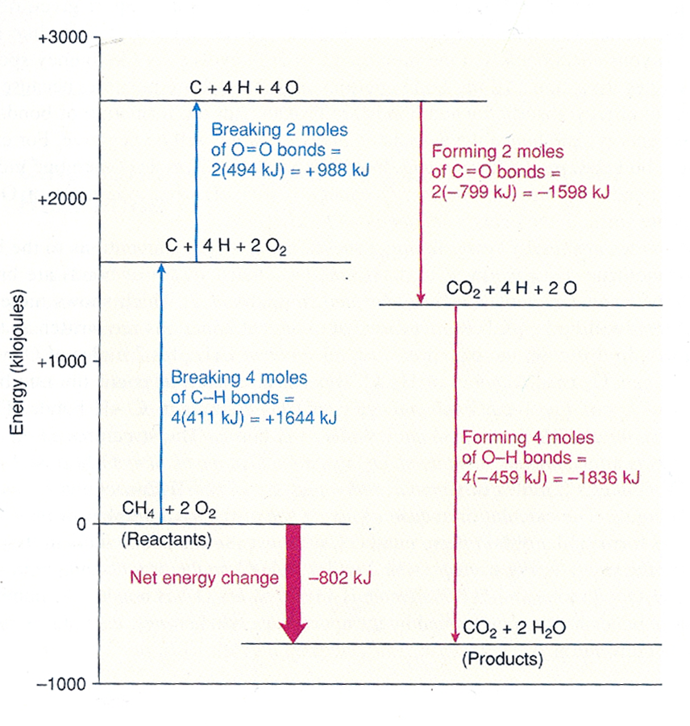
How we think about the energy that is released when we burn fuels
This is true of any fuel
Hydrogen (H₂)
Methane (CH₄ )
Ethane (C₂H₆)
Propane (C₃H₈ )
Coal (mostly C, some S)
Wood (Carbohydrates, “ash”)

